Slide 1

How to read financial statements
By: Nadine El-Saeed

Slide 2
Agenda
How To Read Financial Statements
Balance Sheet
Income Statement
Cash Flow Statement
Ratios

Slide 3
How to read financial statements: (Guide)
Balance Sheet: This statement shows the assets, liabilities, and equity of a company at a specific point in time. The assets are what the company owns, while the liabilities are what the company owes. The equity is the difference between the assets and liabilities. You can find the balance sheet in the company’s financial statements.

Slide 4
How to read financial statements: (Guide)
2. Income Statement: This statement shows the revenue and expenses of a company over a period of time. The revenue is the money earned by the company, while the expenses are the costs incurred by the company. The difference between the two is the net income. You can find the income statement in the company’s financial statements.

Slide 5
How to read financial statements: (Guide)
3. Cash Flow Statement: This statement shows the inflow and outflow of cash for a company over a period of time. The inflow of cash is the money received by the company, while the outflow of cash is the money paid by the company.
You can find the cash flow statement in the company’s financial statements.

Slide 6
How to read financial statements: (Guide)
4. Ratios: Ratios are used to analyze the financial health of a company. Some of the commonly used ratios are:
Profitability Ratio: This ratio measures the profitability of a company by comparing the net income to the revenue.
Liquidity Ratio: This ratio measures the ability of a company to meet its short-term obligations.
Debit-to-Equity Ratio: This ratio measures the amount of debt a company has relative to its equity.
Price-to-Earnings Ratio: This ratio measures the price of a company’s stock relative to its earnings per share.

Slide 7
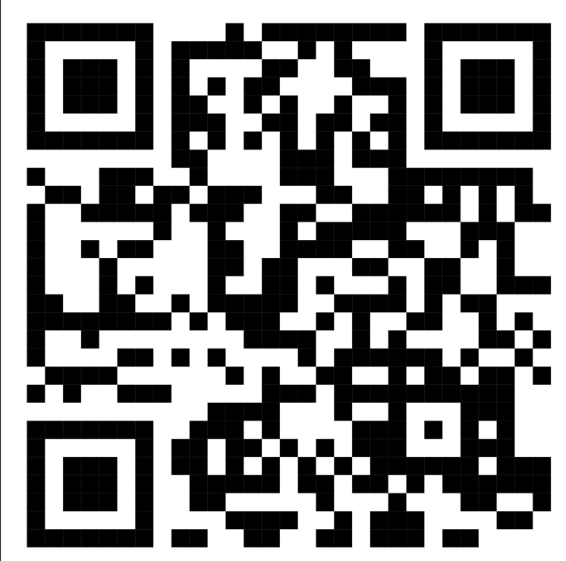

Slide 8
Task
Read the financial statements of Airbnb and answer the following questions:
What is the net income of Airbnb?
What are the assets and liabilities of Airbnb?
What is the cash flow of Airbnb?
What is the profitability ratio of Airbnb?
Based on the answers to these questions, decide the flow of success or failure of the company.

